Slide 1
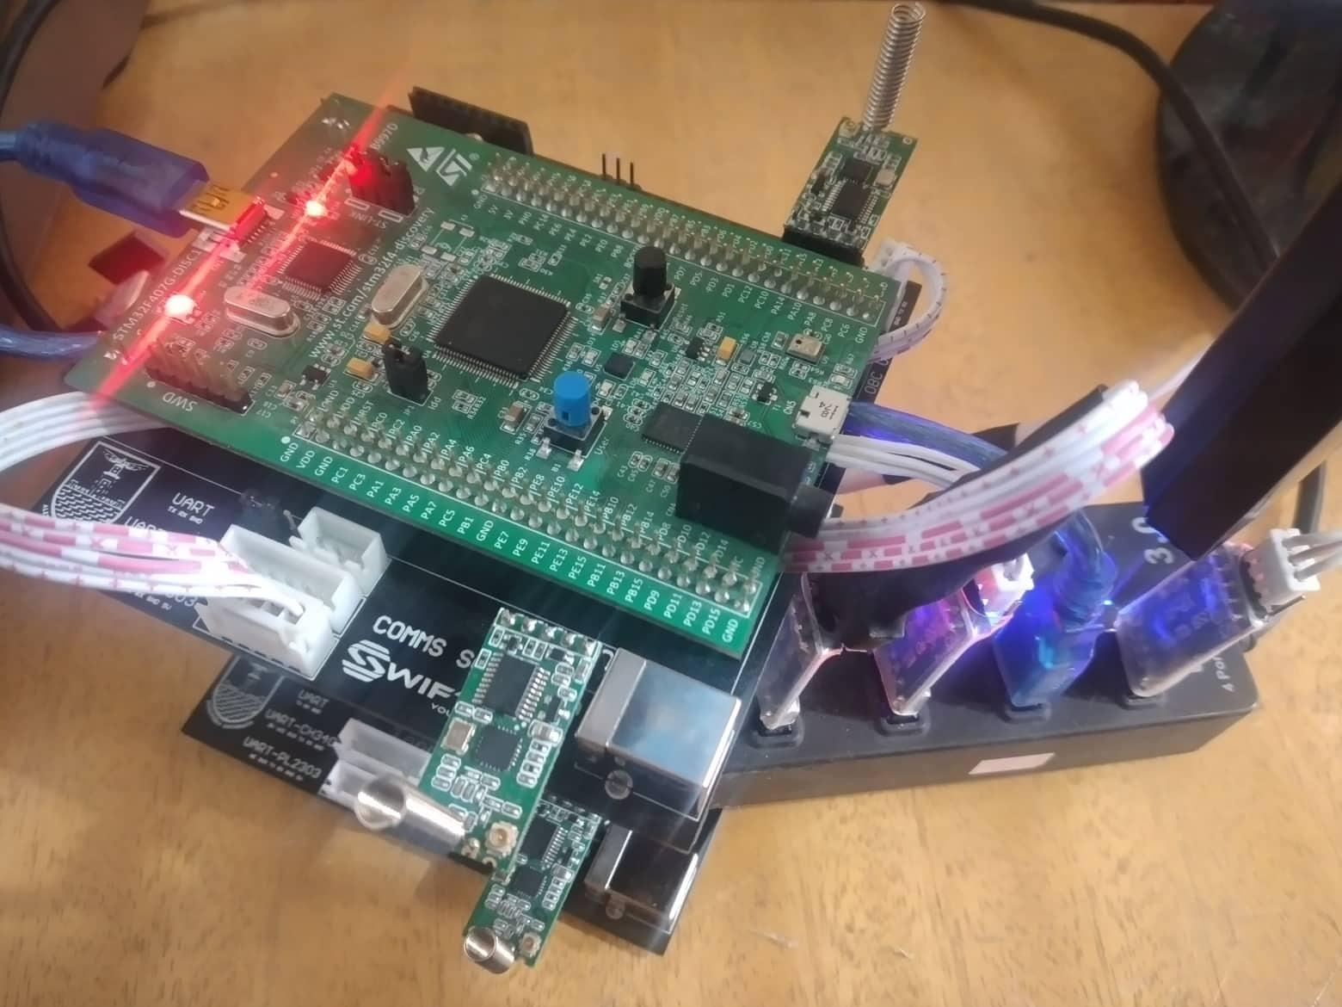
COMM Sub-System

Slide 2

COMMS RESPONSIBILITIES
Ground Link
OBC Link
Handling the data
RX From Ground
TX To Ground
Microcontroller
RX From OBC
TX To OBC

Slide 3
COMMS Architecture
Will add here more simple block diagram
If I have enough time

Slide 4
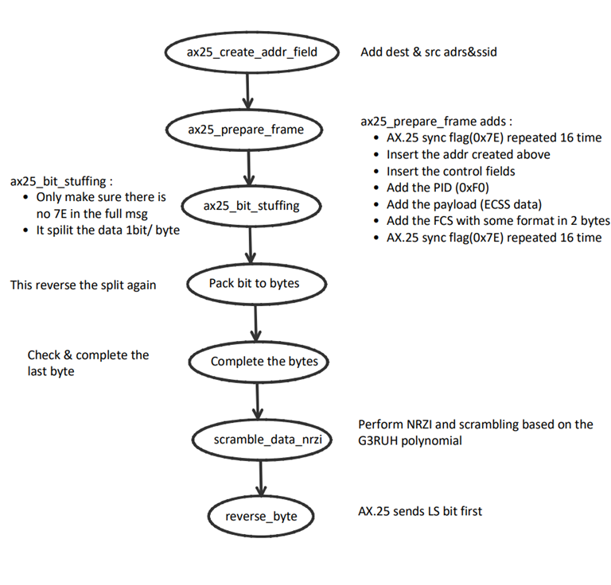
Data process
Transmit/Receive Packets
AX25 encoding/decoding
Packet Framing/Deframing
Firewall incoming packets
Packet Error check

Slide 5
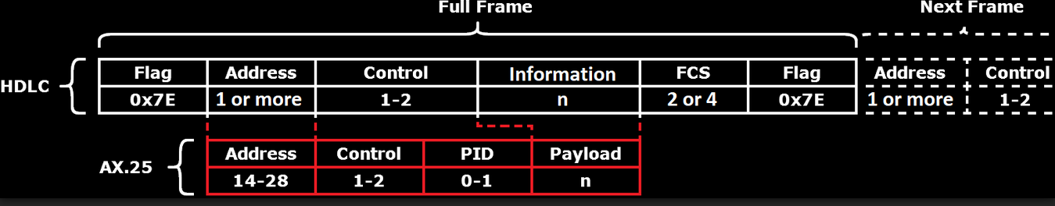
AX.25 Packet

Slide 6
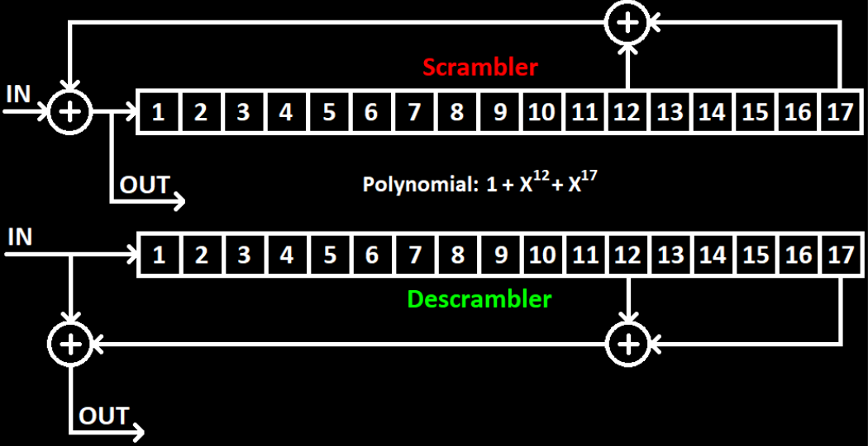
Scrambler

Slide 7
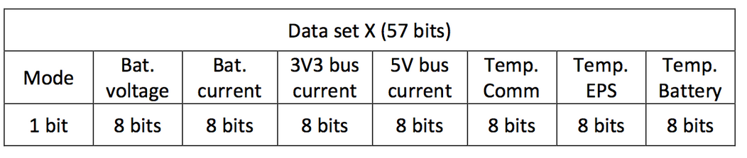
WOD

Slide 8
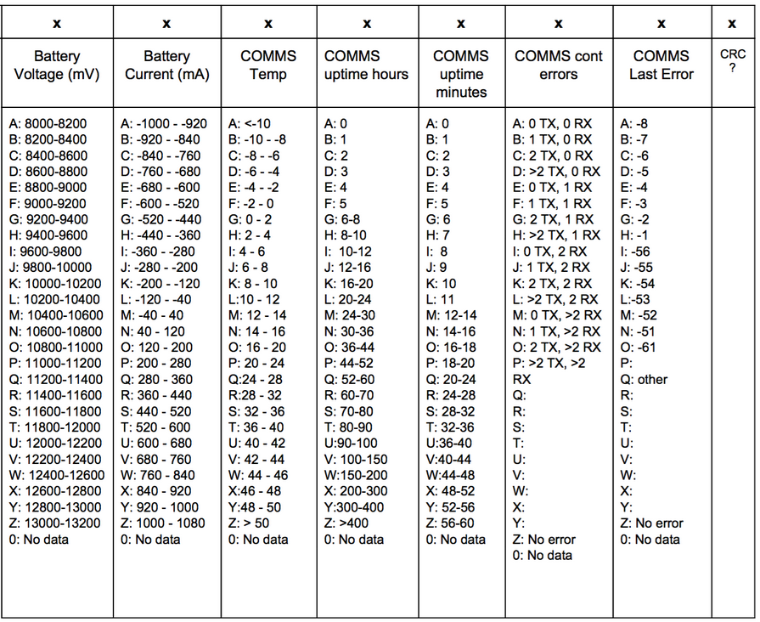
CW Packet

Slide 9
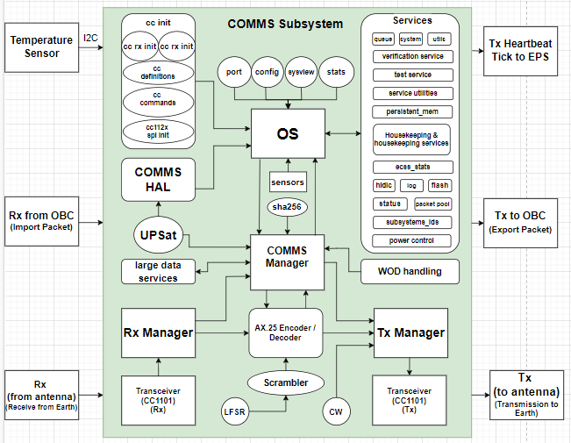
COMMS Static Design

Slide 10
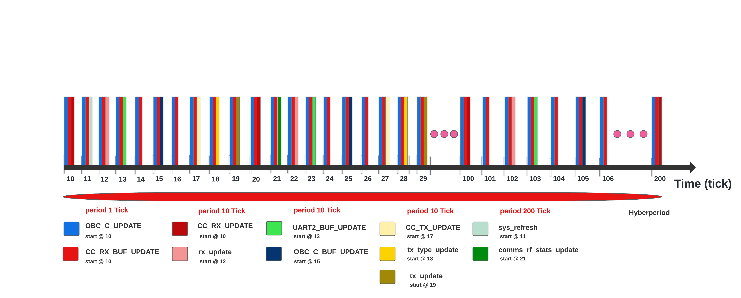
COMMS Dynamic Design

